Slide 1
Arduino and the WS2811 LED Array
Ryan Brock

Slide 2
About Me
Ryan Brock
Software Engineer – 14 Years
Purdue University – Computer Science
Motorola
Zebra Technologies

Slide 3
Contact
Twitter: @borq79
Email: borq79@gmail.com
Github Repo:
https://github.com/borq79/Cary-Area-Public-Library-Classes

Slide 4
Agenda
Review of some basics (20 mins)
Arduino
Breadboards
Resistors
LEDs
Capacitors
Introduction to WS2811 (25 mins)
Color Wheel
Single Wire Programming
Projects
Simple Color Bar
Adjust Brightness
Chase and Fade
Equalizer

Slide 5
Arduino Uno

Slide 6
Breadboard

Slide 7
Wiring up a Circuit

Slide 8
Resistors

Slide 9
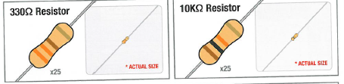
Vilros Kit Resistors
V = IR
I = V / R
I = 5V / 330 = 0.015A (15 mA)
I = 5V / 10,000 = 0.0005A (0.5 mA)

Slide 10
LEDs

Slide 11
Why is one lead longer?

Slide 12
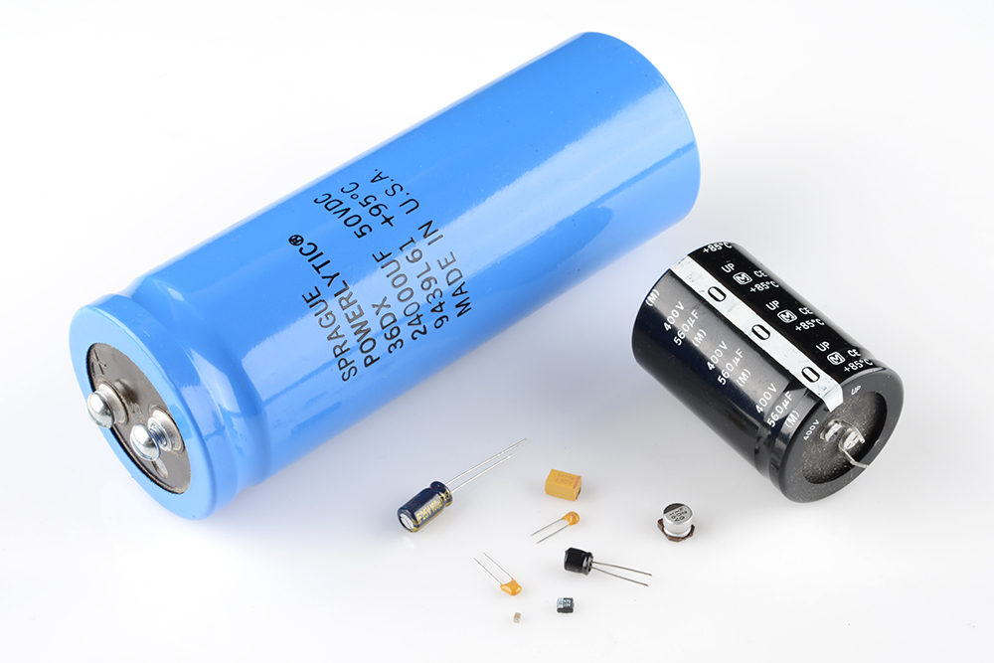
Capacitors

Slide 13
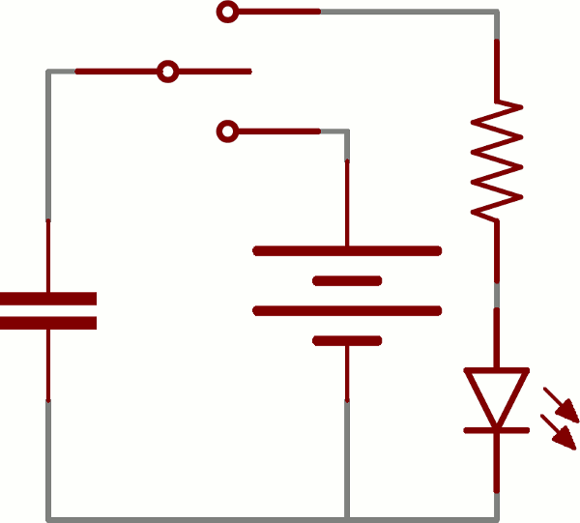
Charging up a Capacitor
Image from: https://learn.sparkfun.com/tutorials/capacitors

Slide 14
Adafruit NeoPixel
The Magic of NeoPixels:
https://learn.adafruit.com/adafruit-neopixel-uberguide/
https://www.youtube.com/watch?time_continue=41&v=HO6xQMR8naw

Slide 15
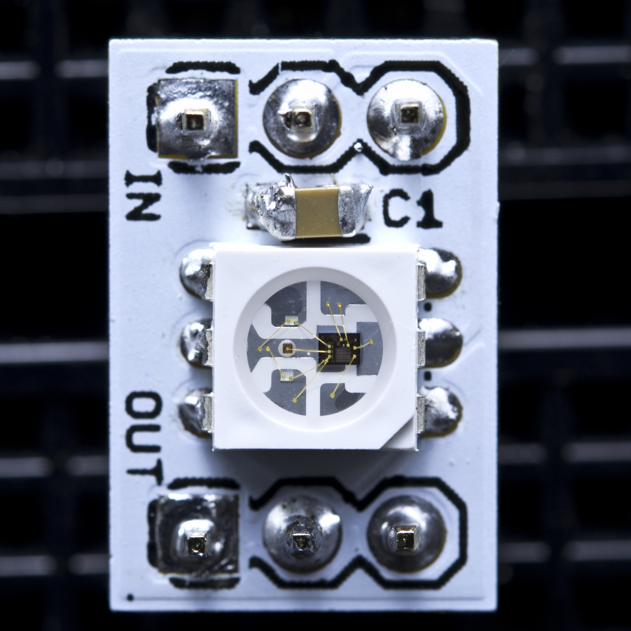
WS2811

Slide 16
WS2811
Datasheet: https://www.adafruit.com/datasheets/WS2811.pdf
A ‘chain’ if 24-bit color sequences
Each pixel’s WS2811 IC will program itself and send the rest of the chain down the line

Slide 17
24, and 32-bit Color
3 LEDs – Red, Blue, and Green
8-bits for each pixel
0 – 255 different brightness levels for each pixel

Slide 18
24, and 32-bit Color
Three colors mix to create 2²⁴ (16,777,216) color combinations, or 24-bit color
32-bit color includes transparency, but ignored for NeoPixels

Slide 19
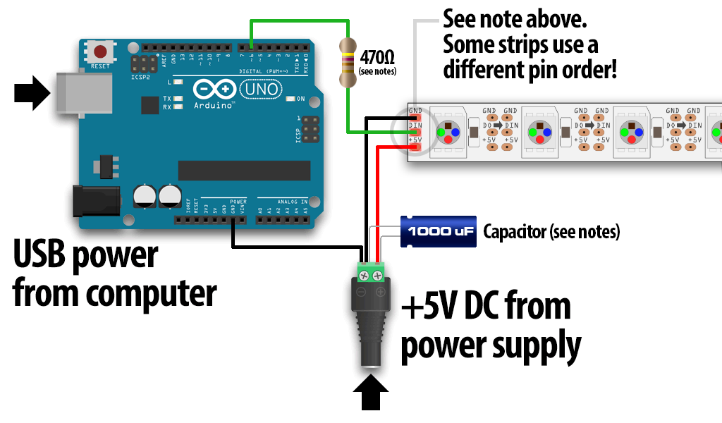
Powering the Strip
Sources: https://learn.adafruit.com/adafruit-neopixel-uberguide/basic-connections

Slide 20
Adafruit NeoPixel Library
Go to: https://learn.adafruit.com/adafruit-neopixel-uberguide/arduino-library-installation
Download the library (big green button)
Uncompress the ZIP file
Create a directory named WS2811 in c:\Program Files\Arduino\Libraries
Copy Adafruit_NeoPixel.cpp and Adafruit_NeoPixel.h
Re-Start the Arduino IDE

Slide 21
Initialization
// Parameter 1 = number of pixels in strip
// Parameter 2 = pin number (most are valid)
// Parameter 3 = pixel type flags, add together as needed:
// NEO_KHZ800 800 KHz bitstream (most NeoPixel products w/WS2812 LEDs)
// NEO_KHZ400 400 KHz (classic 'v1' (not v2) FLORA pixels, WS2811 drivers)
// NEO_GRB Pixels are wired for GRB bitstream (most NeoPixel products)
// NEO_RGB Pixels are wired for RGB bitstream (v1 FLORA pixels, not v2)
Adafruit_NeoPixel strip = Adafruit_NeoPixel(60, PIN, NEO_GRB + NEO_KHZ800);
void setup() {
strip.begin();
strip.show(); // Initialize all pixels to 'off'
}

Slide 22
Set a Pixel’s Color
// Set each color component individually
strip.setPixelColor(n, red, green, blue);
// Set via 32-bit (24-bit) color
strip.setPixelColor(n, color);
// Don’t forget to ’refresh’ the pixel
strip.show();

Slide 23
Project Parts List
Arduino
Breadboard
USB Cable
1 Neo Pixel Strip with 8 LEDs
1 1000F Capacitor (provided by Ryan)
1 10K Ohm resistor (in kit)
3 Male-Female wires (provided by Ryan)
3 Male-Male wires (in kit)

Slide 24
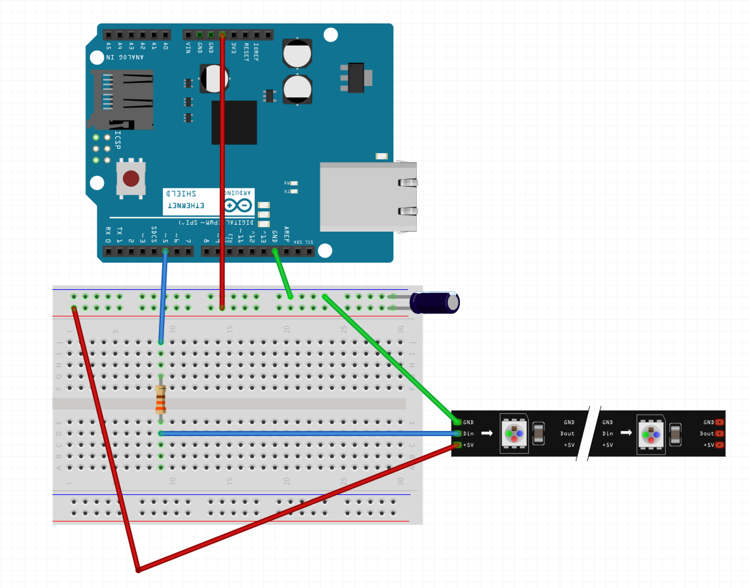
Project Wiring Diagram

Slide 25
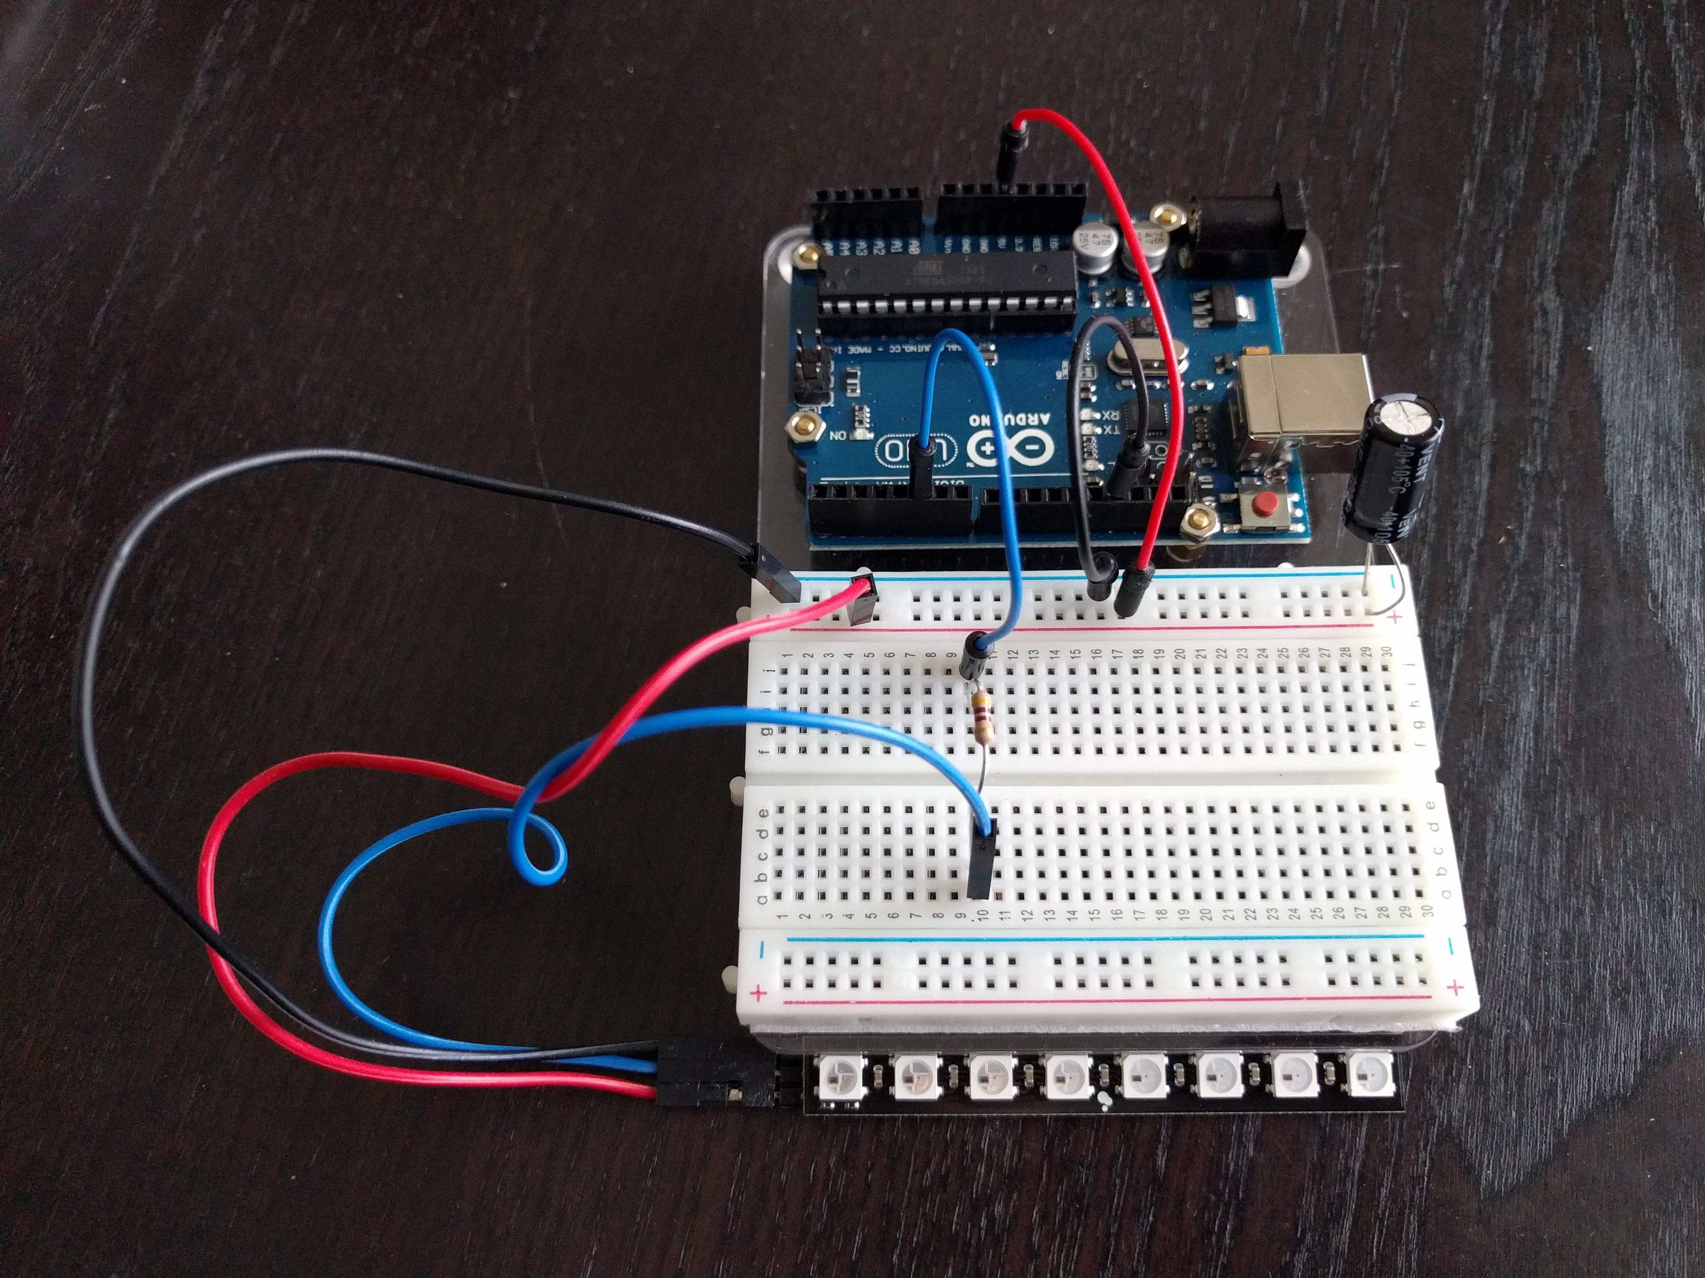
Project Wiring Photo

Slide 26
Project One Code
https://github.com/borq79/Cary-Area-Public-Library-Classes
ws2811
simple_color_bar
simple_color_bar.ino

Slide 27
Set a Pixel’s Brightness
// DO NOT USE!
strip.setBrightness(n, brightness);
// Take pixel color and adjust brightness by adding or subtracting
// RED at 100%, 75%, 50%, 25%, and off
strip.setPixelColor(n, 0xFF, 0x00, 0x00);
strip.setPixelColor(n, 0xBF, 0x00, 0x00);
strip.setPixelColor(n, 0x7F, 0x00, 0x00);
strip.setPixelColor(n, 0x40, 0x00, 0x00);
strip.setPixelColor(n, 0x00, 0x00, 0x00);

Slide 28
Project Two Code
https://github.com/borq79/Cary-Area-Public-Library-Classes
ws2811
chase_and_fade
chase_and_fade.ino

Slide 29
Daisy Chain
With a partner:
Power down the Arduino (unplug the USB cable)
Wire up one strip’s DO to another strip’s DI
Wire Vcc and Gnd together
Change the Pin count to 16
Plug in the USB cable
Program the Arduino

Slide 30
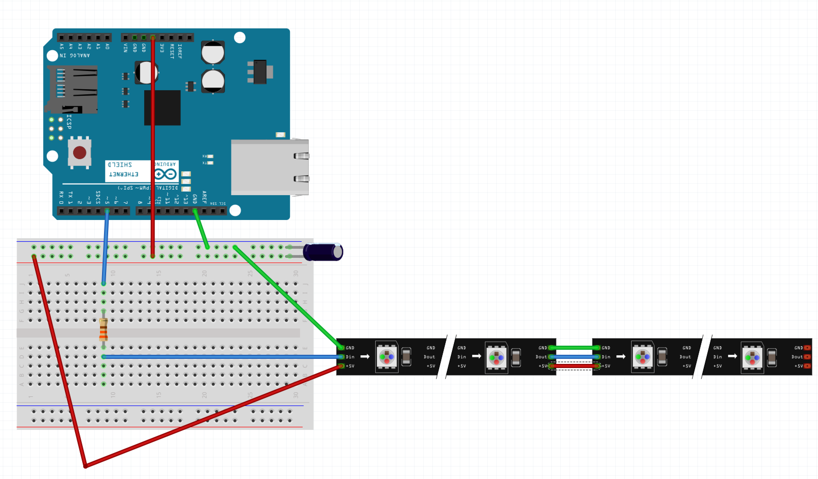
Daisy Chain Wiring Diagram

Slide 31
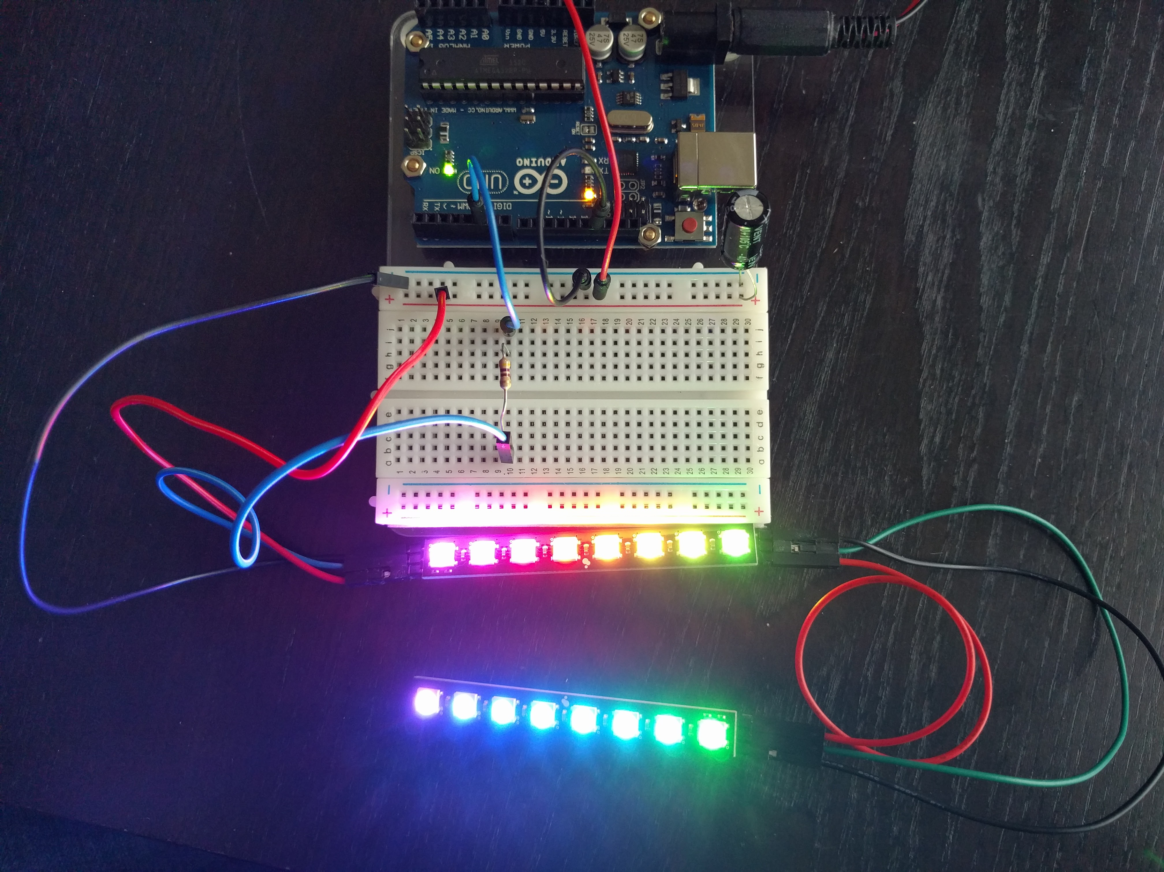
Dual Strip Wiring Photo

Slide 32
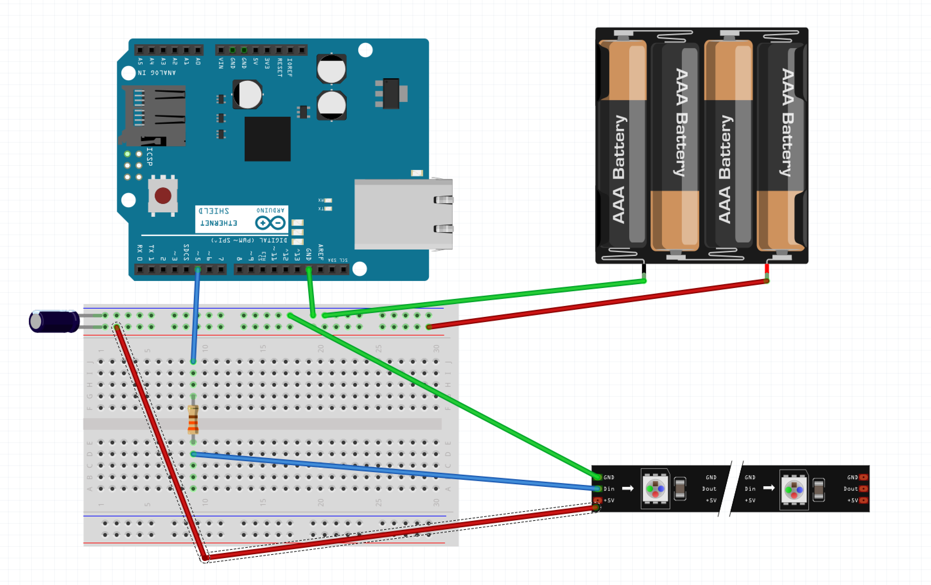
External Power Wiring Diagram For More than 16 Pixels

Slide 33

Make an Equalizer

